Slide 1
Surface Pattern Recognition Using Shape Subspace
Naish Ibrahim
Supervisor: Kazuhiro Fukui

Slide 2
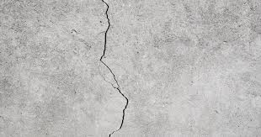
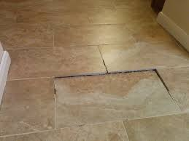
Research Problem
How can Subspace-based methods be used to detect surface irregularities in Point Cloud data?
Notes:
The central question driving my research is: 'How can Subspace-based methods be effectively utilized to detect surface irregularities in Point Cloud data?' This addresses the core challenge of accurately identifying subtle or significant anomalies, such as the cracks in concrete or uneven floor tiles you see in these images. These are common examples of surface irregularities that our method aims to detect. Our goal is to develop robust and interpretable techniques that leverage the inherent structural properties of 3D point cloud data.

Slide 3
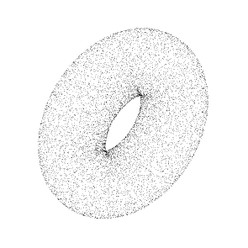
Research Background
Point Cloud Processing
(100,150,100)
Point Cloud processing involves handling 3D data represented as a collection of points in space (x, y, z) coordinates.
Example of point cloud data file
X | Y | Z
100 | 150 | 100
200 | 200 | 210
10 | 50 | 100
35 | 10 | 35
R | G | B
13 | 115 | 24
32 | 102 | 35
15 | 57 | 78
33 | 43 | 25
X | Y | Z
1 | 0 | 3
-1 | 1 | 0
0 | -2 | 0
2 | -1 | 1
Coordinates
Color (Optional)
Normal Vectors (Optional)
Notes:
To understand our method, it's essential to briefly cover the background. First, Point Cloud Processing involves handling 3D data represented as a collection of discrete points in space, each with X, Y, and Z coordinates. As shown in the example table, these points can also include additional attributes like color, represented by RGB values, and normal vectors, which indicate the surface orientation. Point clouds are fundamental in various applications, from 3D reconstruction to autonomous navigation.

Slide 4
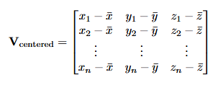
Research Background
Shape Subspace
A mathematical representation of 3D structures based on the relative positions of feature points.
Used for task such as object recognition, motion analysis, and biometric authentication.
Representing high-dimensional data efficiently.
centering
Apply SVD
Centered matrix
Input point cloud
Shape Subspace
Notes:
Next, we delve into Shape Subspace. This is a mathematical representation that captures the intrinsic geometric structure of a set of 3D points, focusing on their relative positions rather than absolute coordinates. It's widely used in tasks like object recognition, motion analysis, and even biometric authentication, primarily because it allows us to efficiently represent high-dimensional 3D shape data in a lower-dimensional linear subspace, preserving essential features.
As the diagram illustrates, Shape Subspace is computed by first centering the input point cloud to remove translational variance. This results in the centered matrix, Vcentered​, as shown in the formula. We then apply Singular Value Decomposition, or SVD, to this centered matrix to derive the Shape Subspace.

Slide 5
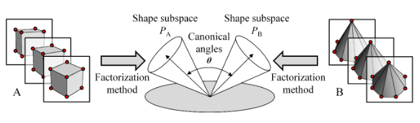
Related Research
How is Shape Subspace computed?
Factorization Approach
Frames of an Image sequence
Frames of an Image sequence
Figure adapted from Igarashi and Fukui, "3D Object Recognition Based on Canonical Angles between Shape Subspaces"
Notes:
Before discussing our specific method, it's helpful to see how Shape Subspace is applied in related research. This slide shows an example from a factorization approach, adapted from work by Igarashi and Fukui. Here, Shape Subspaces are derived from sequences of image frames. The key concept is the use of canonical angles to measure the similarity or difference between two Shape Subspaces, PA​ and PB​. This demonstrates how Shape Subspace provides a powerful tool for comparing and recognizing 3D objects or shapes based on their underlying geometric structure.

Slide 6
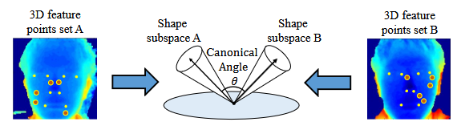
Related Research
How is Shape Subspace computed?
Direct 3D Feature Extraction Approach
Figure adapted from Yoshinuma, Hino, and Fukui, "Personal Authentication Based on 3D Configuration of Micro-feature Points on Facial Surface"
Notes:
Another example, this time from a direct 3D feature extraction approach by Yoshinuma, Hino, and Fukui, illustrates the application of Shape Subspace in personal authentication. Here, 3D feature points extracted from facial surfaces are used to form Shape Subspaces. Again, the canonical angle between these subspaces, A and B, becomes a metric for comparison. These examples highlight the versatility of Shape Subspace in capturing and comparing complex 3D geometric configurations across various computer vision tasks.

Slide 7
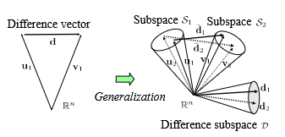
Related Research
The Difference Subspace (DS) is a geometric concept that represents the components of difference between two class subspaces. It extends the idea of a difference vector between two vectors to the case of subspaces.
DS is particularly useful for analyzing and extracting local shape differences between objects, which provides a more sensitive cue for recognition compared to traditional global shape comparison methods.
Figure adapted from Fukui et al., "Second-order Difference Subspace"
Notes:
Building upon Shape Subspace, we introduce the Difference Subspace, or DS. This is a crucial geometric concept that generalizes the idea of a difference vector, which you see on the left, to the case of comparing two subspaces, S1​ and S2​, as depicted on the right. It quantifies the 'difference' between these two shape subspaces.
DS is particularly powerful because it allows us to analyze and extract local shape differences between objects or regions. This provides a much more sensitive and nuanced cue for anomaly detection compared to traditional global shape comparison methods. Its mathematical rigor offers a robust framework for quantifying variations in local geometry.

Slide 8
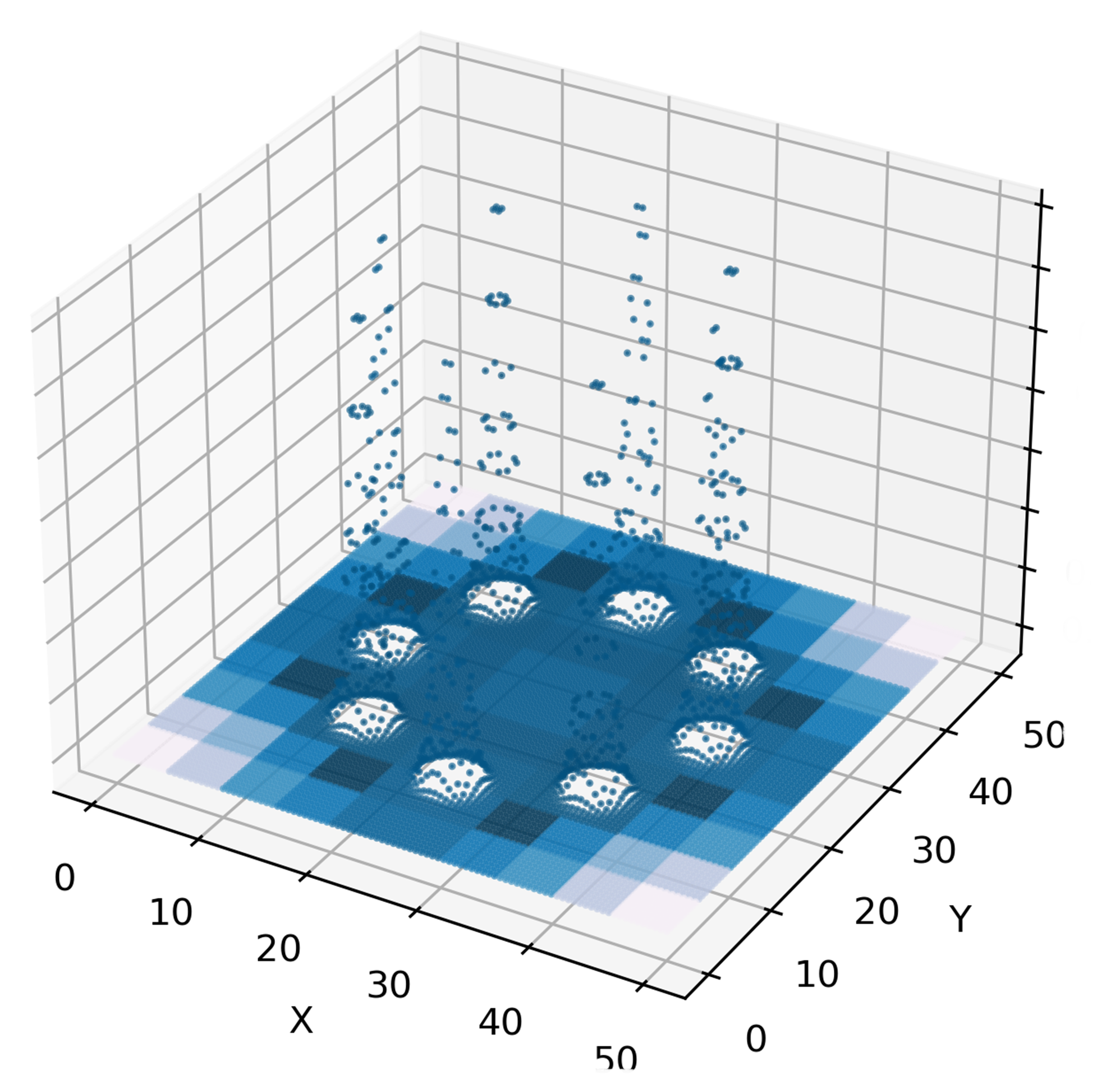
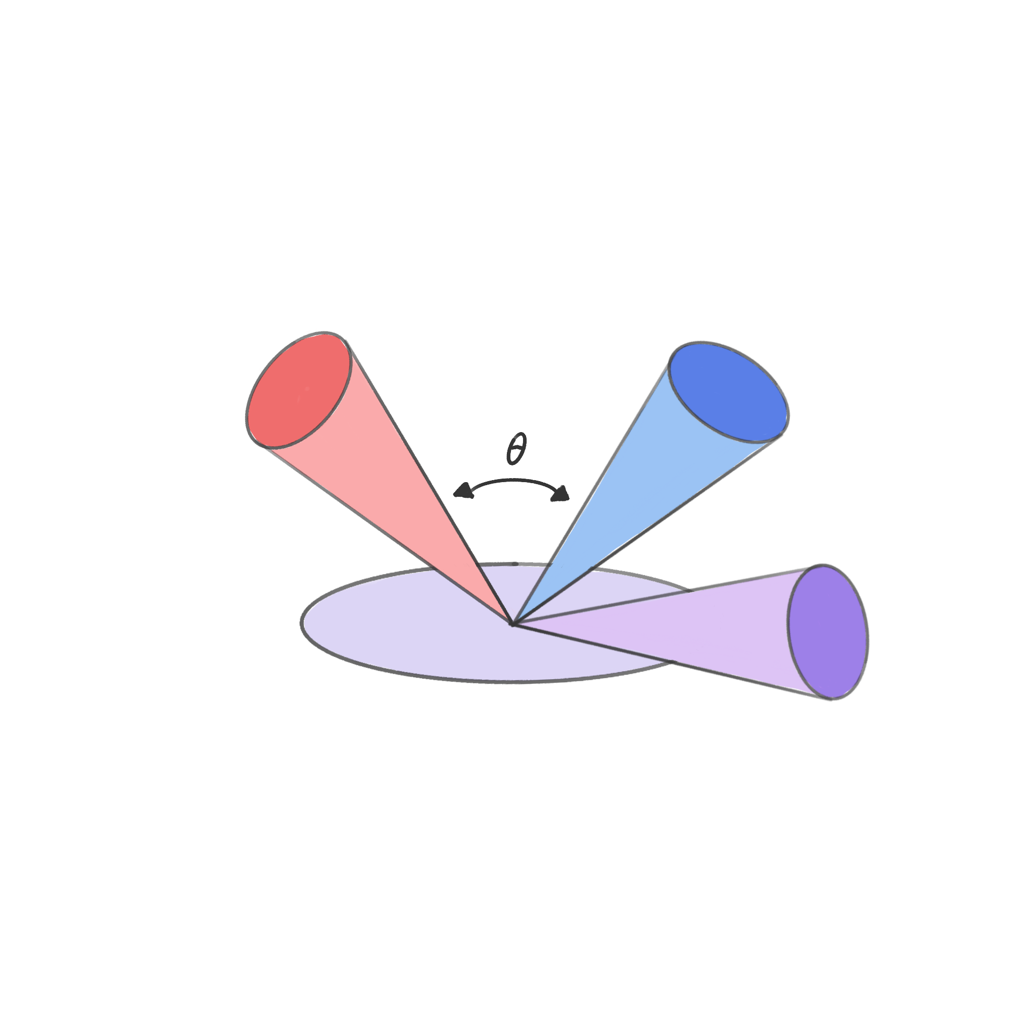
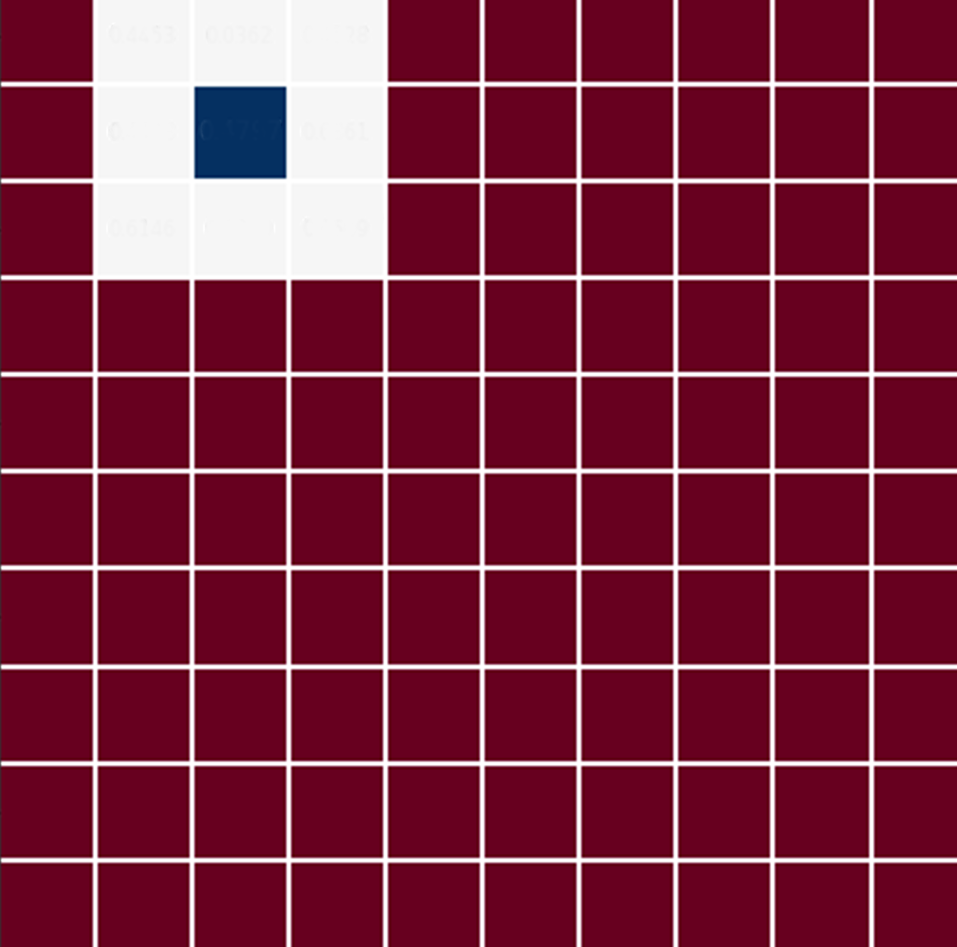
Proposed Method
dividing
centering
Apply SVD
Centered matrix
Shape Subspace
Input Point Cloud
n × n patches
Shape Subspace P
Shape Subspace Q
comparing
Canonical
angles
DS computation
Compare patches using DS
Vector space
Difference Subspace D
Notes:
This slide visually summarizes the methodology of our initial research, which forms the foundation of our proposed method. The process begins with an Input Point Cloud. This cloud is then systematically divided into 'n x n' patches. For each patch, the points are centered, and from this centered matrix, its Shape Subspace is computed by applying SVD. The core of anomaly detection then involves comparing these patches using Difference Subspace (DS). As we saw on the previous slide, the Difference Subspace, D, quantifies the geometric difference between two Shape Subspaces, P and Q, using canonical angles. This DS computation allows us to identify local irregularities across the surface.

Slide 9
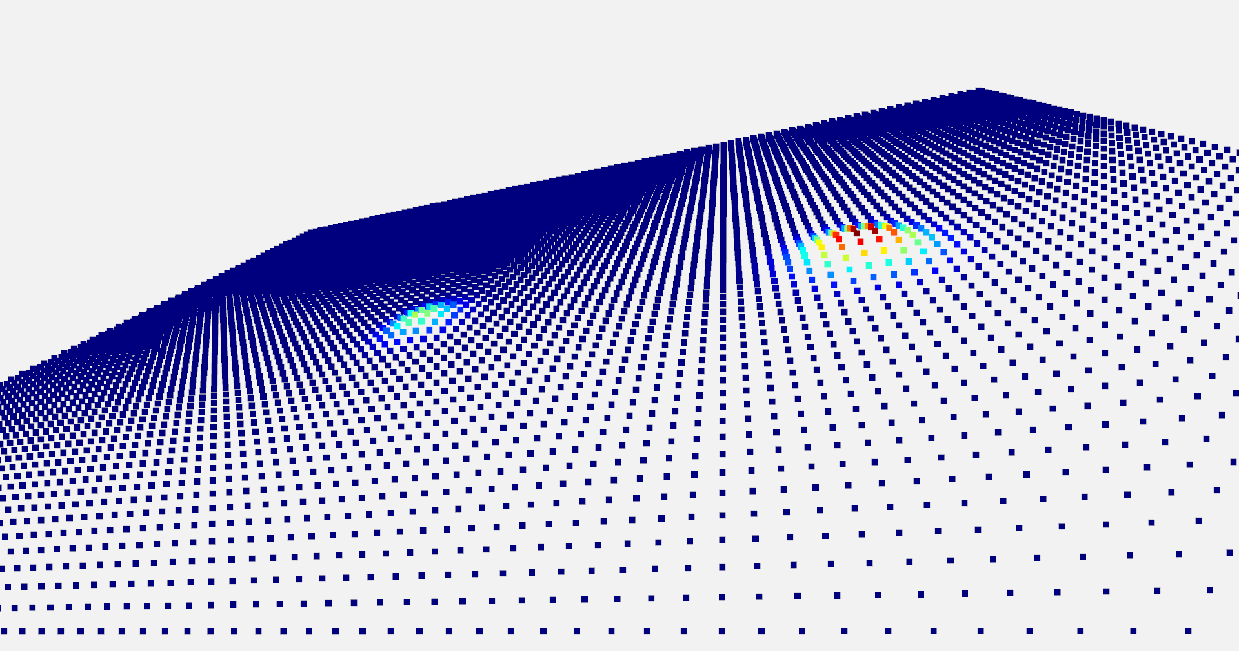
Experiment
Generation of synthetic floor.
Configuration:
The synthetic floor is defined by dimensions of 50 × 50 where each point is spaced exactly one centimeter apart
Total points 10,000
Notes:
To validate our initial method, we conducted experiments using a synthetic floor. This allowed us to have a controlled environment with known ground truth. The synthetic floor was precisely defined with dimensions of 50 by 50 units, with each point spaced exactly one centimeter apart, resulting in a total of 10,000 points. The image on the slide provides a visual representation of this synthetic floor, which we then used to introduce various predefined anomalies.

Slide 10
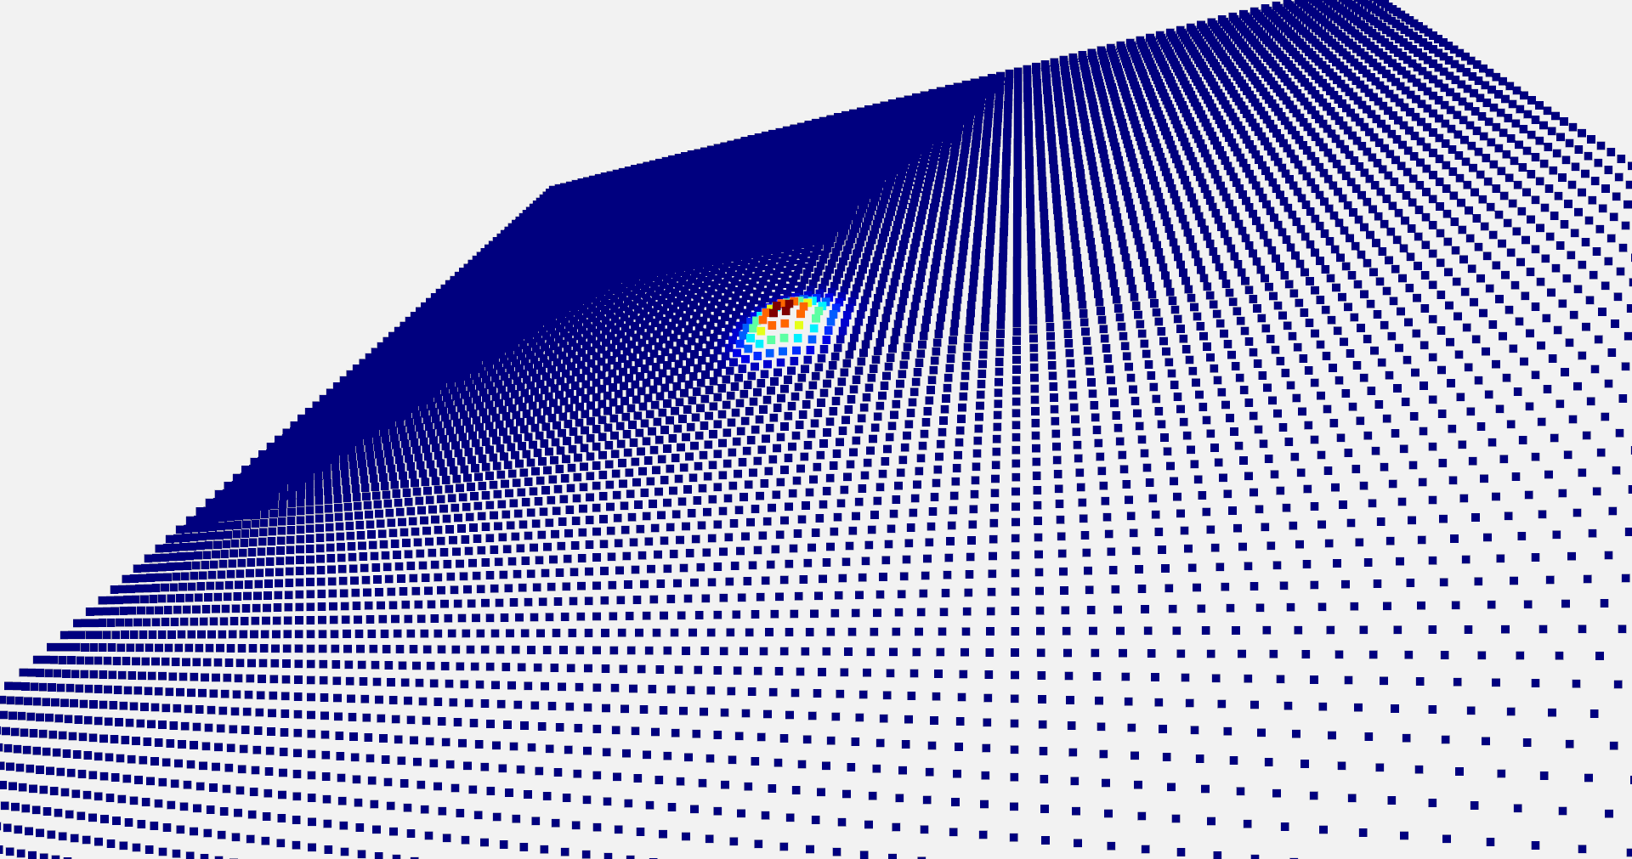
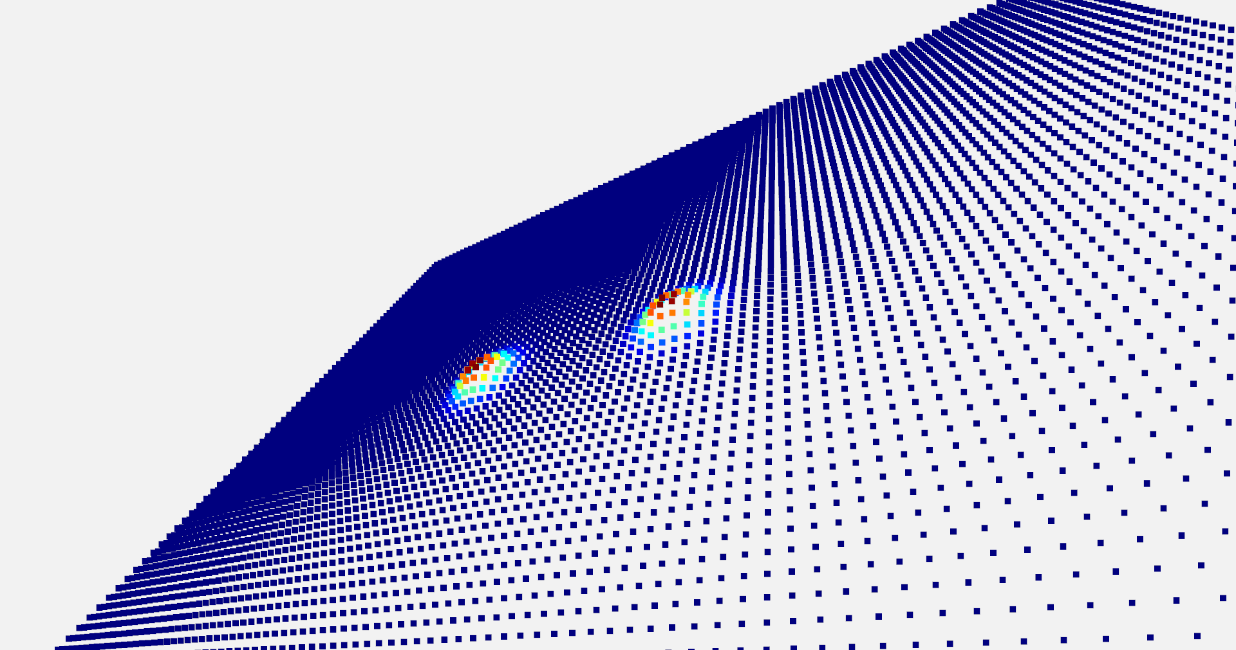
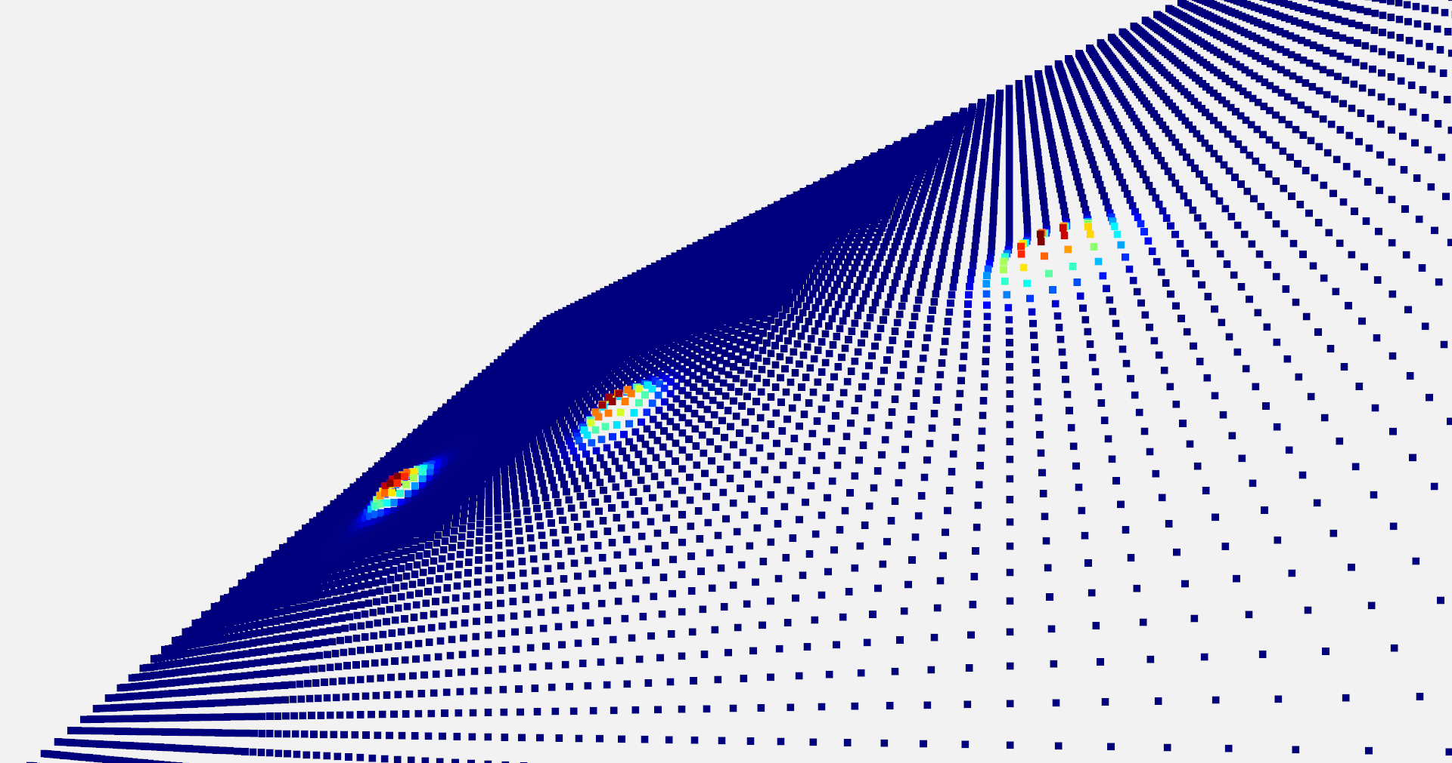
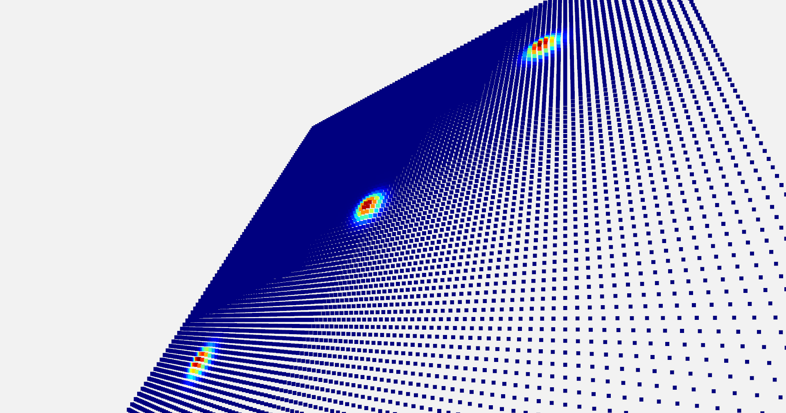
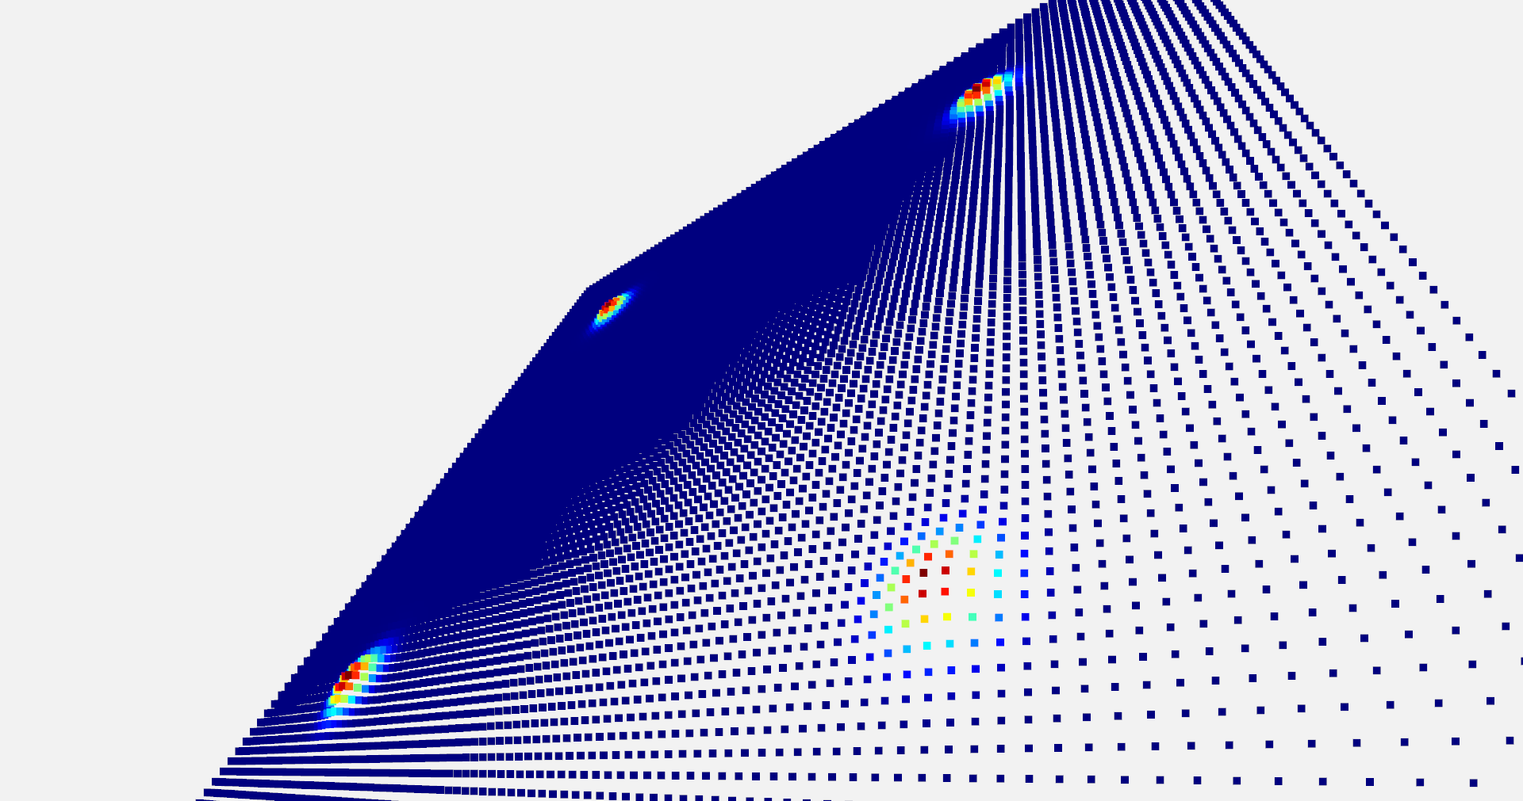
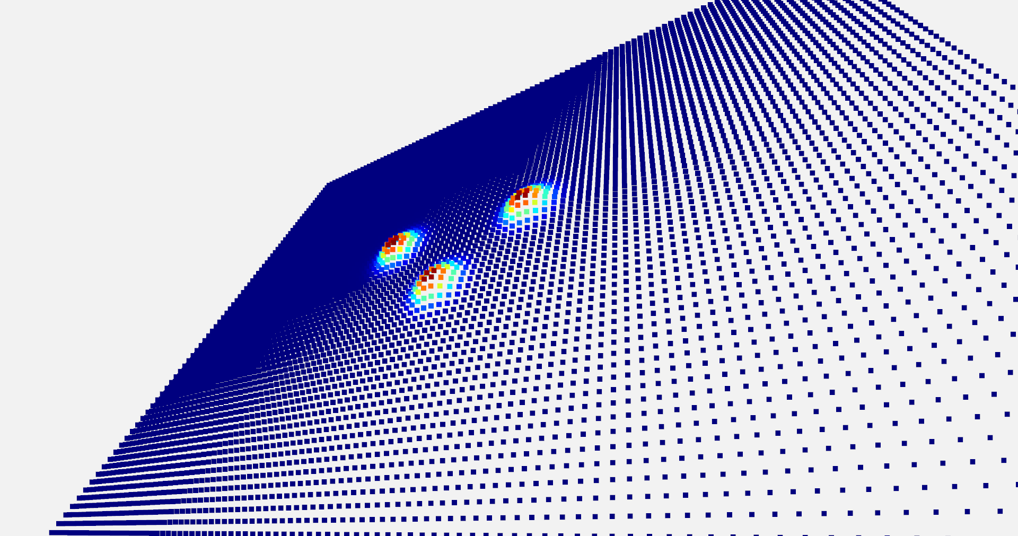
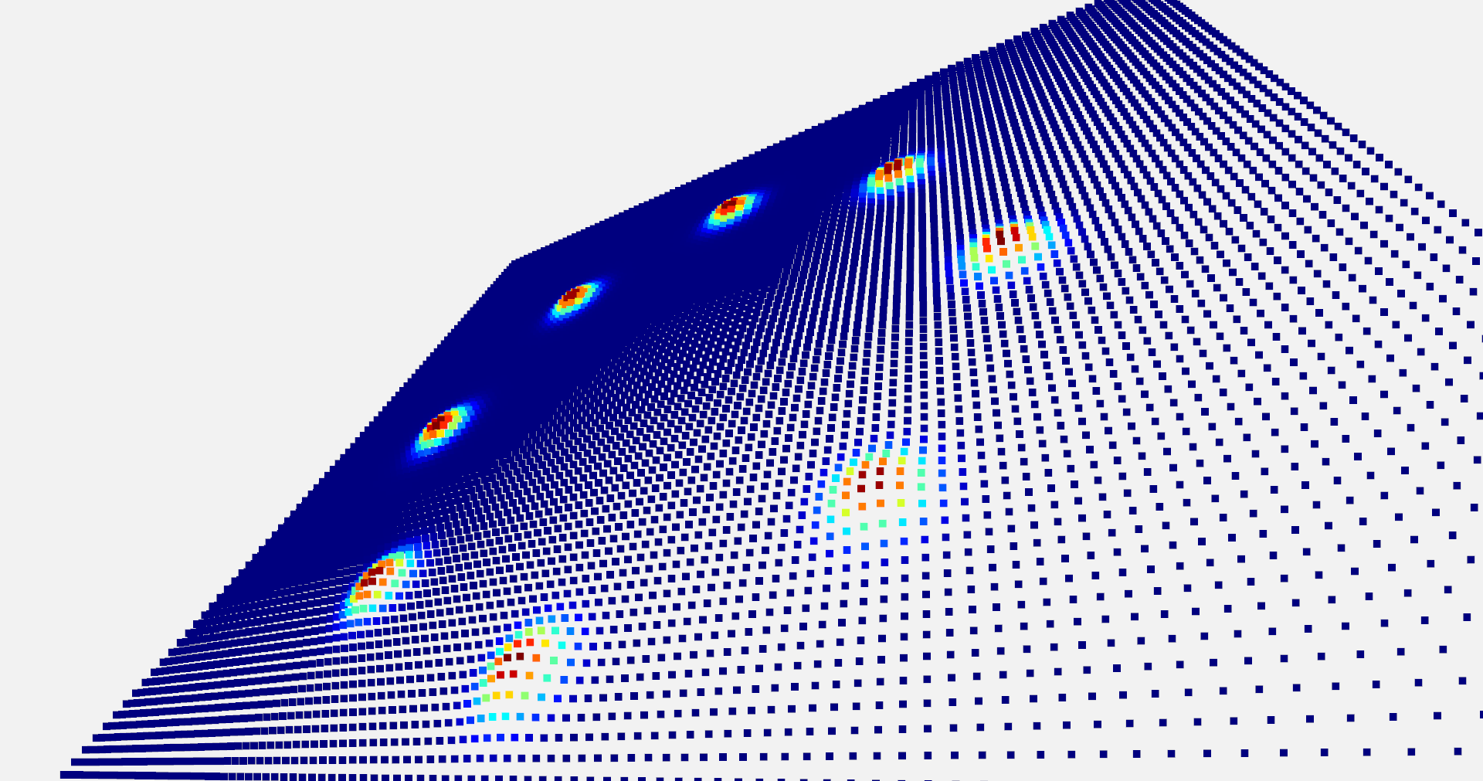
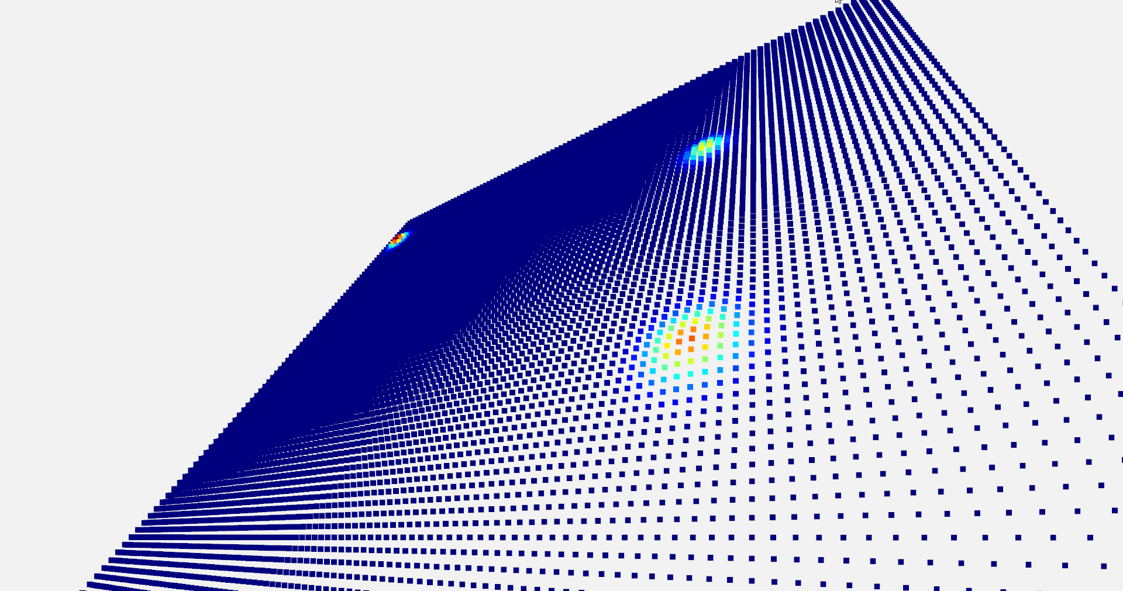
Experiment
Generating predefined or random bumps
Single
Double
Ridge
Diagonal
Corners
Triangle
Circle
Random
Notes:
On this synthetic floor, we generated various predefined or random bumps and patterns to test the detection capabilities of our method. As you can see from these images, we created a range of anomalies, including: a single bump, double bumps, a ridge, a diagonal pattern, corner irregularities, a triangular shape, a circular anomaly, and finally, a random distribution of bumps. This diverse set of patterns allowed us to thoroughly evaluate the method's ability to identify different types of surface irregularities.

Slide 11
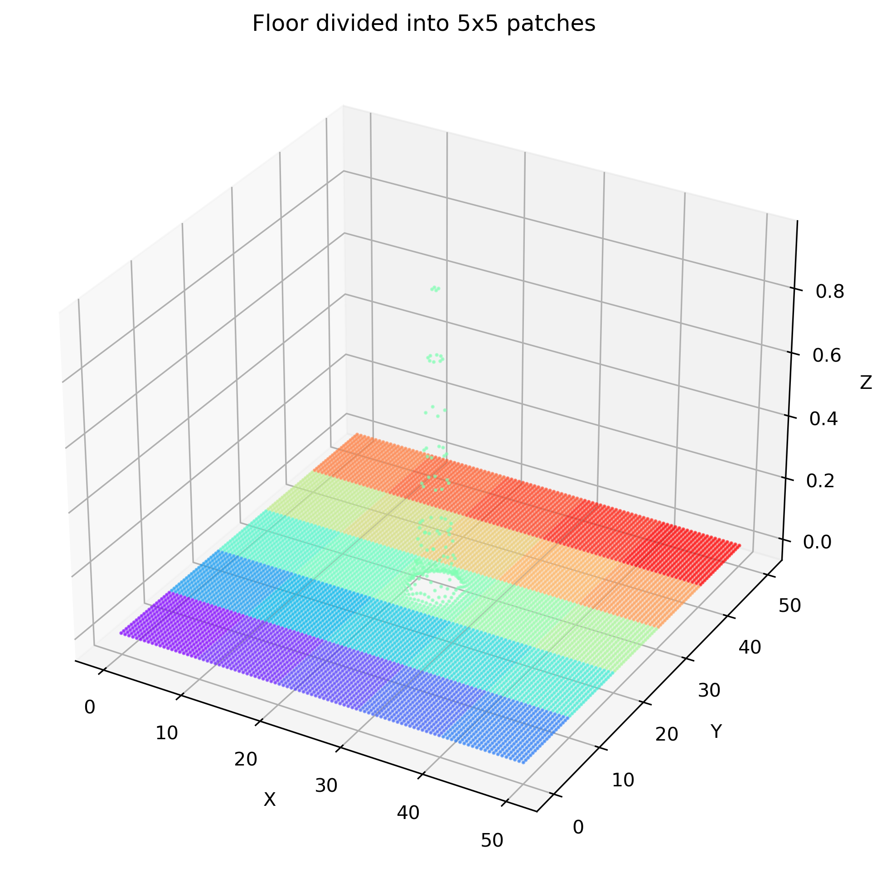
Experiment
Patch division process
Configuration:
Number of patches along x-axis
Number of patches along y-axis
Notes:
In the initial fixed-patch approach, a critical step was the patch division process. The synthetic floor surface was systematically segmented into uniform, non-overlapping patches. The configuration involved defining the number of patches along both the X and Y axes. For instance, the image here shows a floor divided into 5x5 patches. This discrete segmentation was fundamental to how the Shape Subspace and Difference Subspace were computed for localized analysis.

Slide 12
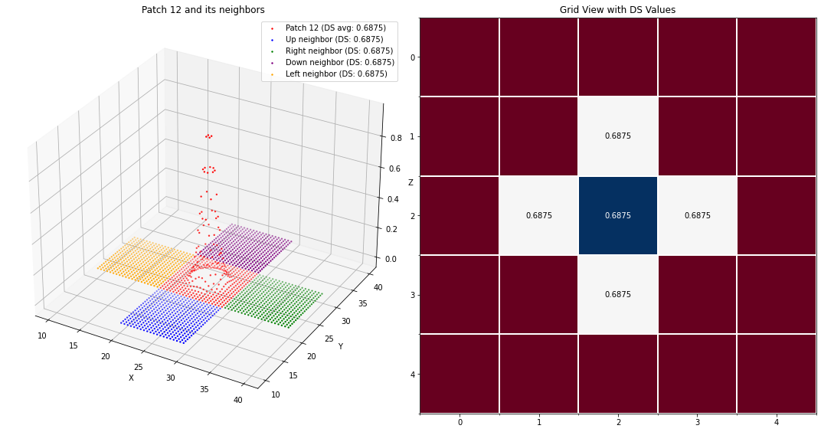
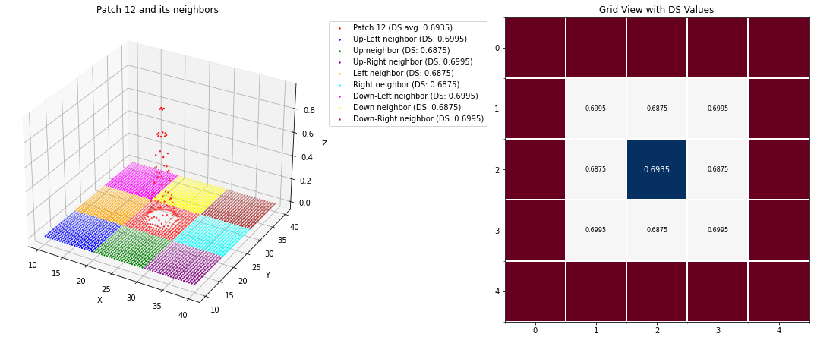
Experiment
DS generation for each patch
4-neighbor approach
8-neighbor approach
Notes:
Once the patches were defined, the Difference Subspace, or DS, was generated for each patch by comparing it with its neighbors. We explored two main approaches: the 4-neighbor approach and the 8-neighbor approach.

Slide 13
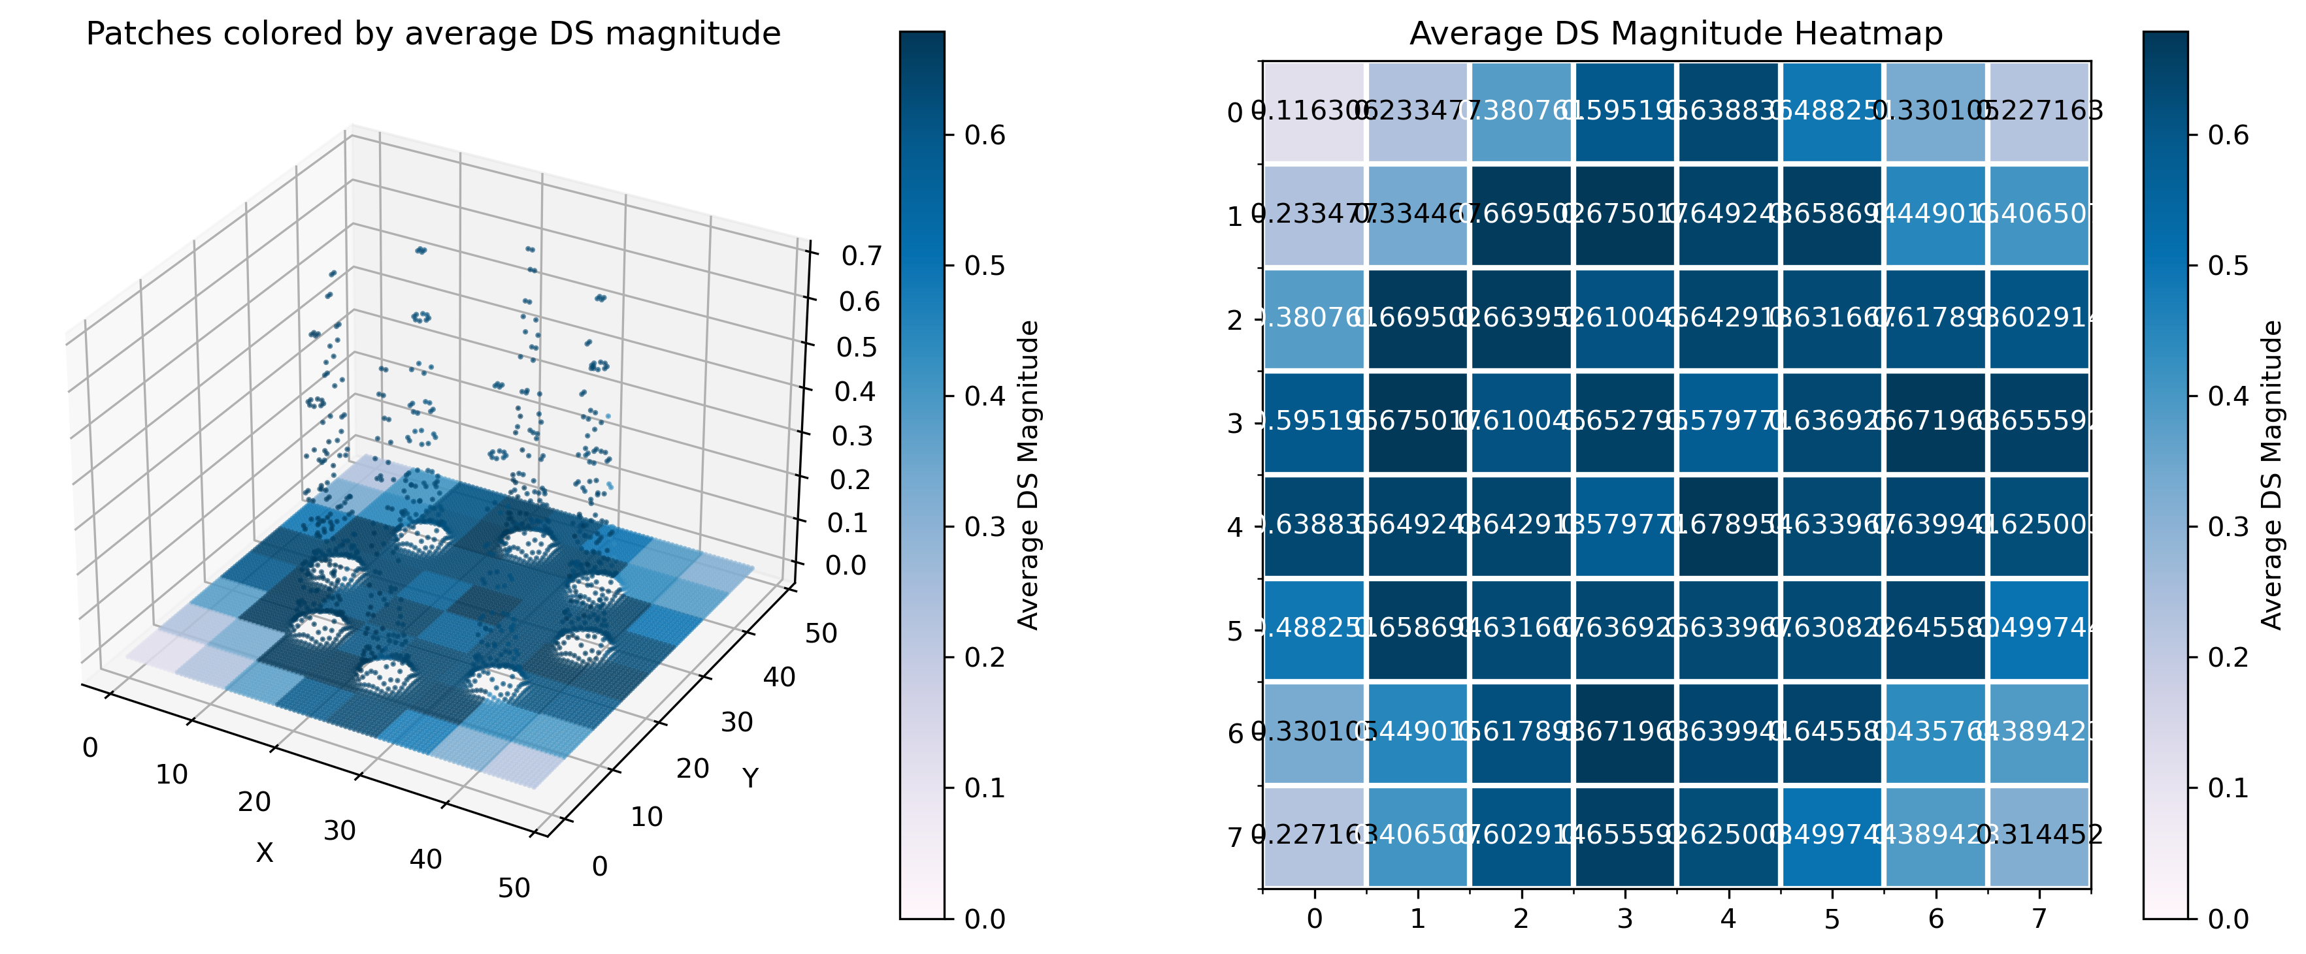
Summary of Initial Research
Methodology
Data: Synthetic 3D floors (50×50 units, 10,000 points) allowed controlled testing with known anomalies.
Segmentation: Floors divided into uniform, non-overlapping patches (e.g., 8×8).
Shape Subspace: Computed using SVD on each patch’s centered matrix.
DS Calculation: Calculated between neighboring patches to quantify local geometric differences.
Key Results
Pattern Detection: Successfully detected synthetic patterns (e.g., bumps, ridges, corners, circles, triangles, random).
Accuracy & Stability:
Smaller patches (3×3, 4×4) improved fine-detail detection.
Eight-neighbor comparisons enhanced stability for complex patterns.

Slide 14
Limitations Identified in Previous Work
Boundary Sensitivity
Issue: Non-overlapping patches may cut across anomalies, weakening signals near edges.
Impact: Less accurate localization; higher risk of false negatives.
Limited Spatial Resolution
Unvalidated on Real-Issue: Sparse, discrete patches limited surface detail.
Impact: Coarse results; harder to detect and locate fine anomalies.
World Data
Issue: Tested only on clean synthetic data.
Impact: Real-world robustness under noise and irregularities was unproven.
Notes:
Although the fixed patch method worked on synthetic data, it had clear limitations.
First, boundary sensitivity—patch borders could cut through anomalies, making detection less accurate. Second, low spatial resolution—non-overlapping patches led to sparse coverage and missed fine details. And third, it was only tested on clean data, so we didn’t know if it could handle noise or irregularities.
These issues led us to develop a more robust approach: the sliding window method.

Slide 15
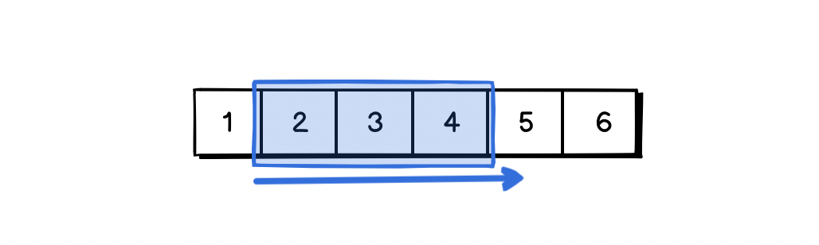
Sliding Window Approach
Concept
Overlapping Analysis Regions: Instead of fixed, discrete patches, the sliding window introduces analysis regions that overlap with configurable percentages.
Continuous Coverage: This overlap ensures that every point on the surface is analyzed multiple times from different window perspectives, mitigating the boundary sensitivity issues of fixed patches.
Increased Spatial Resolution: By generating more analysis points (windows) across the surface, the method achieves a much finer spatial resolution for anomaly localization and characterization.
Notes:
To overcome the earlier limitations, we introduced a sliding window method.
Instead of fixed, separate patches, this method uses overlapping windows. Each point is included in multiple windows, which reduces boundary issues and ensures smoother coverage.
As a result, we get more analysis points and much higher resolution, allowing us to detect anomalies more precisely.

Slide 16
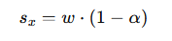
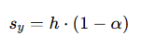
Methodology
Given a point cloud with overall bounding box dimensions (W,H) in the horizontal plane:
Window Size: (w,h) represents the dimensions of each individual analysis window.
Overlap Percentage: α∈[0,1) defines the degree of overlap between adjacent windows (e.g., α=0.5 for 50% overlap).
The stride parameters (sx​,sy​) — the distance the window moves for each step in X and Y directions — are calculated as:
Notes:
Here’s how we define the sliding window setup.
We start with the overall size of the point cloud, W by H, and choose a window size, w by h. We also set an overlap rate—say 50%, which means each window overlaps half with the next.
Using this overlap, we calculate how far each window moves—called the stride. These stride values, in both X and Y directions, control how dense and overlapping our analysis will be.

Slide 17
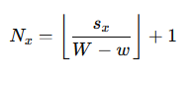
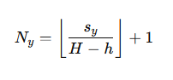
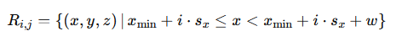
Methodology
The resulting grid dimensions (Nx​,Ny​) — the total number of windows in the X and Y directions become:
Each window Wi,j​ at grid position (i,j) encompasses points within the region defined by:
where (xmin​,ymin​) are the minimum coordinates of the overall point cloud.
Notes:
Building on the previous slide, we calculate how many windows fit across the point cloud—these are Nx and Ny.
Each window, at position (i, j), covers a specific region defined by formulas based on the minimum x and y values. This ensures every window samples the right section of the point cloud for analysis.
These definitions give us precise, consistent coverage for shape subspace computation.

Slide 18
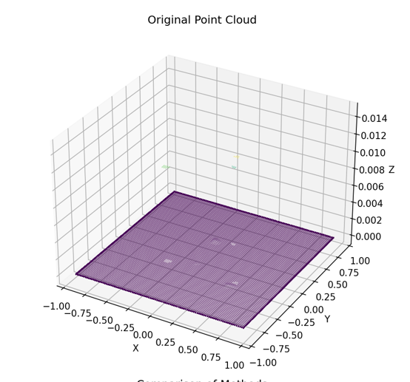
Experimental Validation
Comparison Methods
Fixed Patches (Baseline): 8×8 grid (64 patches), used as reference.
Sliding Window (Proposed): 50% overlap between windows, increasing analysis density.
Data Used
Synthetic Data:
Artificial 3D floor (50×50 units, ~10,000 points)
Includes predefined patterns (bumps, ridges, corners, etc.)
Real-World Data:
Format: PLY (Polygon File)
61,914 points from a noisy floor scan
Notes:
To compare methods, we tested fixed patches vs. our proposed sliding window approach.
The fixed patch baseline used an 8×8 grid—so 64 analysis points. Our sliding window used 50% overlap, giving much denser coverage.
We ran experiments on two datasets:
A clean synthetic floor (50×50 units, ~10,000 points) with known patterns,
And a real-world noisy scan ('floor.ply') with over 61,000 points, shown in the image.

Slide 19
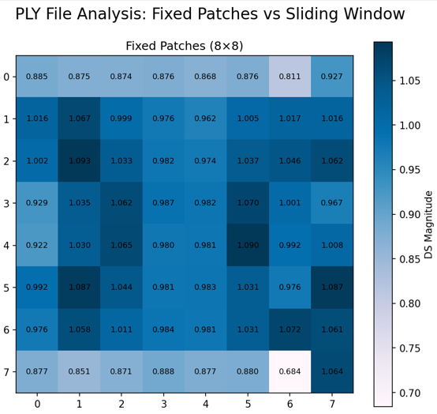
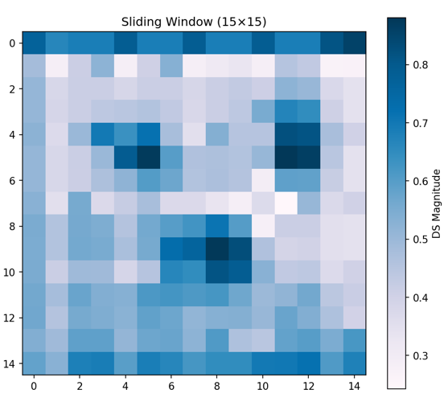
Experimental Validation
Common Settings
Subspace Dim: Set to 3 for all computations.
Neighbors: Used 8-neighbor DS calculation for context.
Sliding Overlap: Fixed at 50% for better coverage and resolution.
Preprocessing
Centering: Removed translation for geometry-only focus.
Downsampling (Optional): Reduced density to ease computation.
Min Point Filter: Ensured enough points per patch/window for stable SVD.
Notes:
Both methods used the same core settings: subspace dimension was set to 3, and we used 8 neighbors for DS calculation to capture more context. For sliding windows, the overlap was fixed at 50%.
Before computing, we applied three key preprocessing steps:
Centering, to remove translation effects.
Optional downsampling for heavy point clouds.
And filtering out regions with too few points to ensure stable SVD.
The heatmaps on the right show a preview of the results. You can already see how the sliding window gives smoother, more continuous outputs compared to fixed patches.

Slide 20
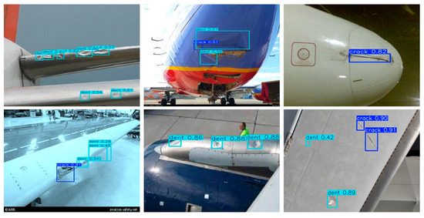
New Problem: Dent Inspection
Motivation
Dent inspection is currently a manual, tedious, and subjective process, prone to human error. Dents are subtle, smooth deformations without clear boundaries.
Challenge
How do we automatically segment these dents from 3D point clouds?
Lack of labeled training data is a major hurdle.
Dents have no distinctive features.
Engineers require interpretable and trustworthy results.

Slide 21
Connecting Previous Work
Recap of Initial Research
We explored Shape Subspace methods on synthetic floors.
Fixed Patch Analysis: Successfully detected known patterns (bumps, ridges).
Sliding Window Extension: Provided 3.5x higher resolution and handled noisy, real-world PLY files more effectively.

Slide 22
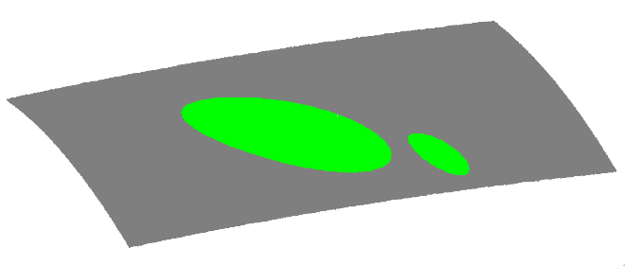
A Solution: DentNet's 2.5D Strategy
Handling 3D Data Efficiently
The DentNet paper introduces an elegant 2.5D strategy:
Quadric Surface Fitting: A bivariate quadratic function, z(x,y), is fit to the 3D point cloud to capture the baseline aircraft curvature.
Residual Calculation: The distance of each point from this fitted surface is calculated. Dents appear as high-residual regions.
This effectively converts the complex 3D data into a 2D residual map, which is fast, memory-efficient, and highlights deformations for a CNN.

Slide 23
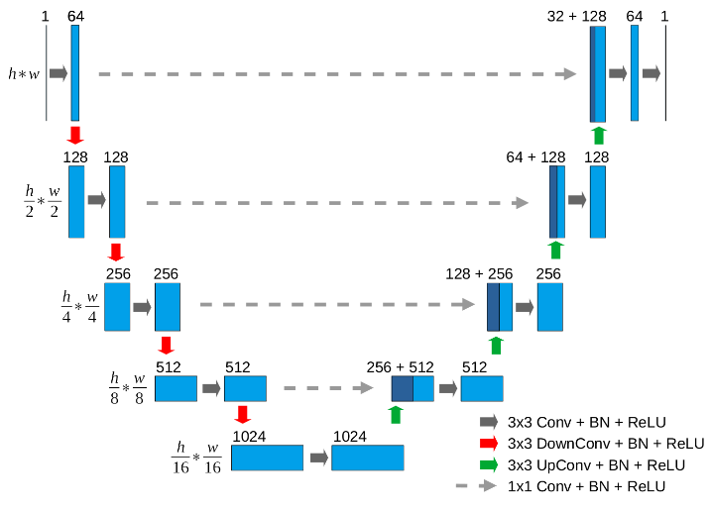
DentNet Architecture (U-Net FCN)
A U-Net for Segmentation
DentNet uses a Fully Convolutional Network based on the U-Net architecture.
Encoder (Downsampling): Extracts features at multiple scales, with a 1024-channel bottleneck.
Decoder (Upsampling): Reconstructs the full-size segmentation mask.
Skip Connections: Propagate fine details from the encoder to the decoder, crucial for precise boundaries.
The model was trained on 30,000 synthetic samples and achieved 99.24% IoU (Intersection over Union) on synthetic validation data.

Slide 24
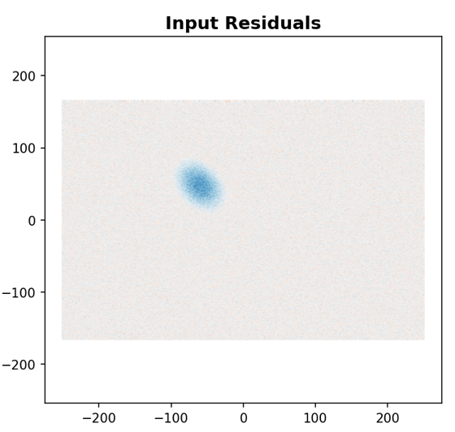
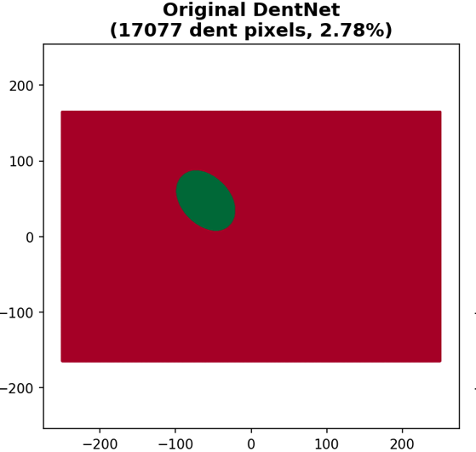
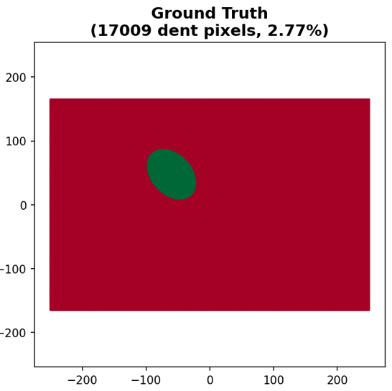
DentNet Synthetic Test Results
Performance on Synthetic Data
On a synthetic test sample, DentNet achieves 98.97% IoU.
The output shows:
Input Residuals: The dent is clearly visible as a blue depression.
Probability Map: Hot colors indicate high confidence of a dent.
Final Prediction: The boundaries are smooth, accurate, and (green) match the ground truth.

Slide 25
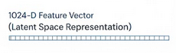
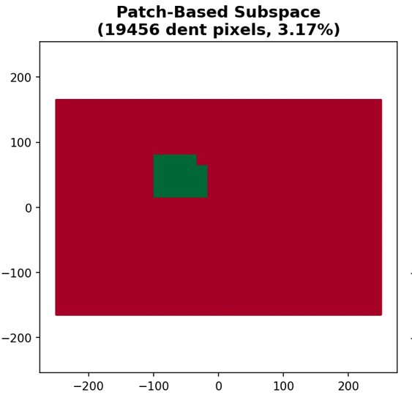
Our Approach: Patch-Based Subspace
Dent Subspace
Normal Subspace
dividing
Feature Extraction
Classification
Build "Dent" & "Normal" subspaces (50 PCs each) via PCA. Classify patch by distance to each subspace.
Input Point Cloud
Use a sliding window (64x64 patches, 50% overlap) to get ~700 patches per image.
reconstruction
Aggregate overlapping patch predictions (voting) to generate the final segmentation mask.

Slide 26
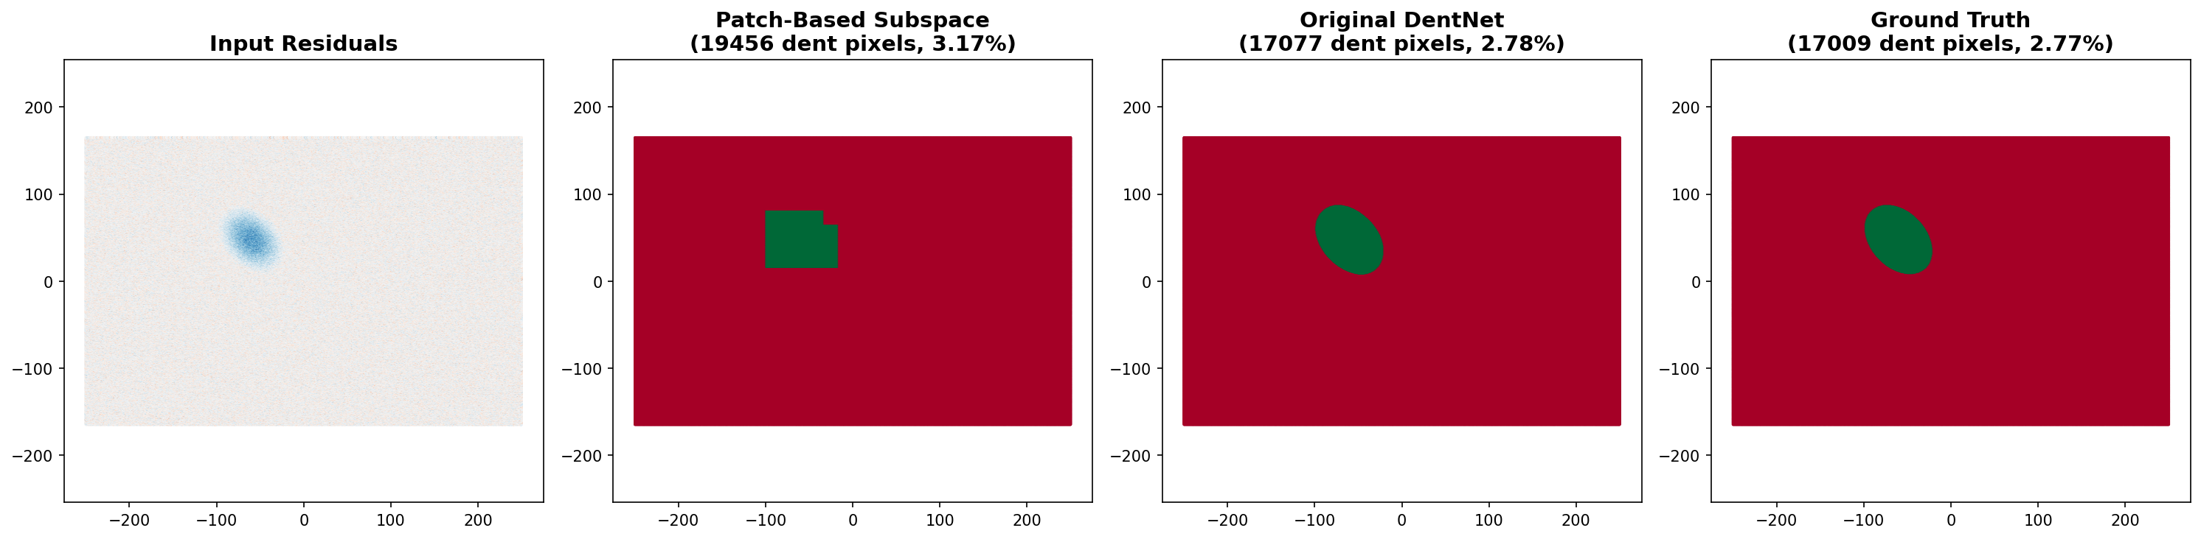
Results

Slide 27
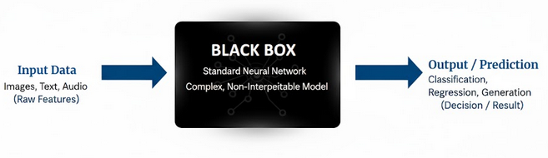
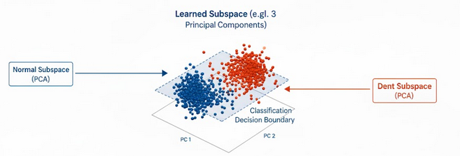
Why Subspace Methods? Interpretability
Beyond the "Black Box"
Unlike a standard neural network, the subspace approach is highly interpretable.
We can visualize the learned patterns.
We can see which features define "dent-ness".
We can quantitatively explain *why* a patch was classified (its distance to the subspaces).
This allows for validation with domain experts.

Slide 28
Comparison on Synthetic Sample
DentNet
98.97% IoU
Very accurate, smooth, circular boundaries.
Very close to ground truth.
Patch-Based Subspace
74.92% IoU
Lower performance, blocky boundaries (due to 64x64 patches).
Slightly overshoots the dent area.
However, the classification is fully interpretable.

Slide 29
Real-World Challenges
Struggles on Real Data
When tested on real aircraft scans, both methods struggled.
Sample A (0.78mm dent):
DentNet: 41.61% False Positives. Detects scan "strip boundaries" as dents.
Patch-Based: 20.65% False Positives. Better, but still problematic.

Slide 30
Analysis: Why Do Both Methods Fail?
Domain Gap
Training data (clean, synthetic) lacks real-world scan artifacts like stitching "strip boundaries". The models misinterpret these as anomalies.
Quadric Fitting Issue
Training: Fit *excludes* dent points (uses ground truth). Inference: Fit *includes* all points (no mask), "flattening" the dent and making it invisible.
Magnitude Mismatch
Training was on 1-3mm dents. Real data was 0.78mm (too shallow) or 15mm (too deep), falling outside the trained range.

Slide 31
Summary
Implemented DentNet (99.24% synthetic IoU) and a Patch-Based Subspace approach.
Synthetic: DentNet is highly accurate (98.97%); Patch-based is interpretable but less precise (74.92%).
Real Data: Both methods struggle. The patch-based approach shows slightly better generalization to noise (20.65% False Positive vs 41.61% False Positive ).
Connection: This confirms our initial finding: patch-based/sliding-window methods can be more robust to noise and domain gaps.
Main Lesson: The domain gap and preprocessing (quadric fitting) are the most significant challenges to solve for real-world deployment.

Slide 32
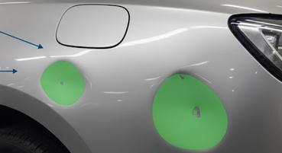
Future Work
Test on Real World Samples
Fine-tune the model on a small, curated set of labeled real-world scans to bridge the domain gap.
Robust Quadric Fitting
Use RANSAC to automatically exclude outliers (like dents) from the initial surface fit.

Slide 33
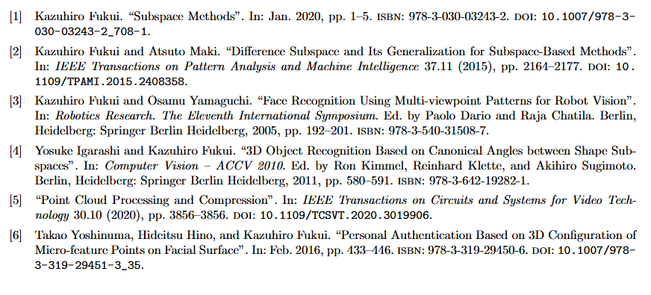
References

